Slide 1
NHLBI
Deep Learning Crash Course
National Heart, Lung, and Blood Institute
Fall 2021

Slide 2
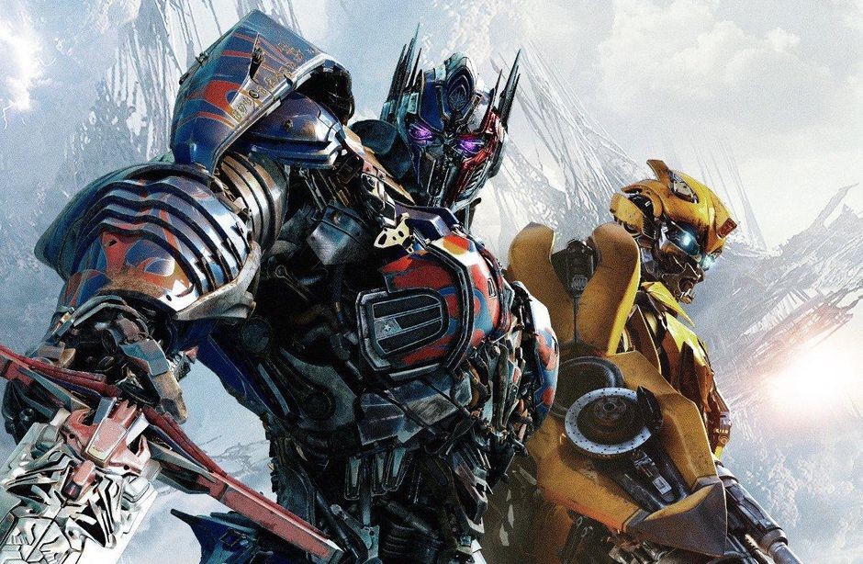
Outline
Attention mechanism in detail
Seq2Seq Transformer
Review on Elmo, Bert, GPT models
Trending towards bigger model
Attention for images
https://www.cnet.com/news/transformers-animated-movie-in-production-despite-coronavirus-quarantine/

Slide 3
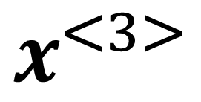
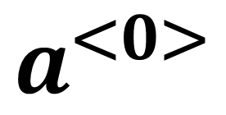
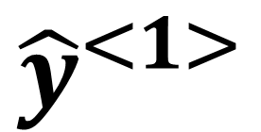
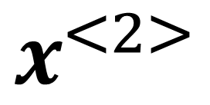
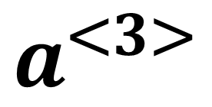
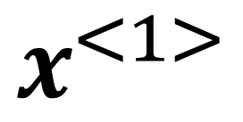
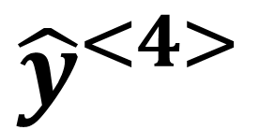
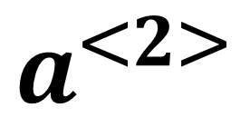
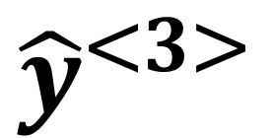
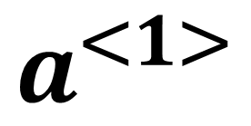
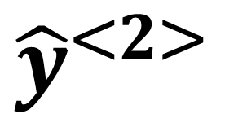
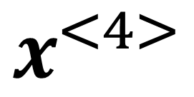
Modeling sequence with variable length
$${\hat{y}}^{<1>}$$
$${\hat{y}}^{<2>}$$
$${\hat{y}}^{<3>}$$
$${\hat{y}}^{<4>}$$
RNN or bidirectional RNN
Sequential processing
Use internal state to carry information through time
$$a^{<1>}$$
$$a^{<2>}$$
$$a^{<3>}$$
$$a^{<0>}$$
$$x^{<1>}$$
$$x^{<2>}$$
$$x^{<3>}$$
$$x^{<4>}$$

Slide 4
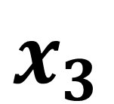
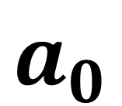
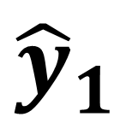
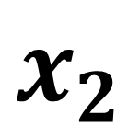
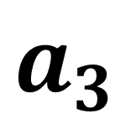
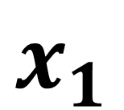
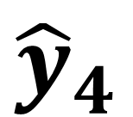
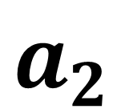
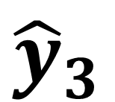
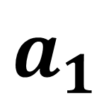
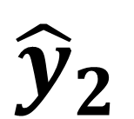
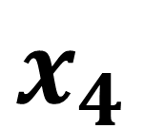
Modeling sequence with variable length
Change the notation for time steps
$${\hat{y}}_{1}$$
$${\hat{y}}_{2}$$
$${\hat{y}}_{3}$$
$${\hat{y}}_{4}$$
RNN or bidirectional RNN
Sequential processing
Use internal state to carry information through time
$$a_{1}$$
$$a_{2}$$
$$a_{3}$$
$$a_{0}$$
$$x_{1}$$
$$x_{2}$$
$$x_{3}$$
$$x_{4}$$

Slide 5
Best of two worlds
$${\hat{y}}_{1}$$
$${\hat{y}}_{2}$$
$${\hat{y}}_{3}$$
$${\hat{y}}_{4}$$
FC
FC
FC
FC
Parallel processing
Handle sequence data with variable length
$$x_{1}$$
$$x_{2}$$
$$x_{3}$$
$$x_{4}$$

Slide 6
Best of two worlds: self-attention
$${\hat{y}}_{1}$$
$${\hat{y}}_{2}$$
$${\hat{y}}_{3}$$
$${\hat{y}}_{4}$$
Parallel processing
Handle sequence data with variable length
Every output takes contributions from all inputs
$$x_{1}$$
$$x_{2}$$
$$x_{3}$$
$$x_{4}$$

Slide 7
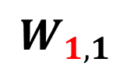
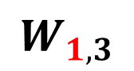

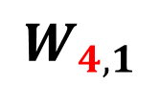
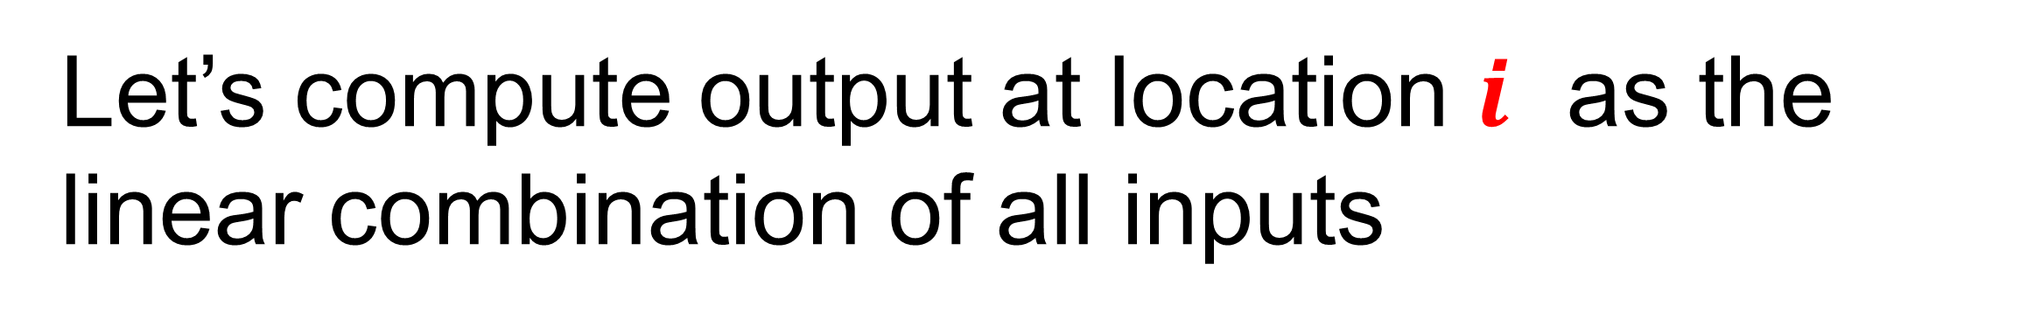
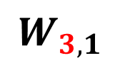
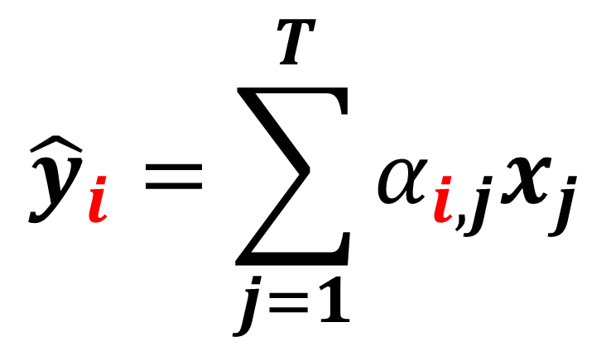
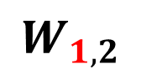
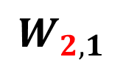
Self-attention
Let’s compute output at location $i$ as the linear combination of all inputs
$${\hat{y}}_{1}$$
$${\hat{y}}_{2}$$
$${\hat{y}}_{3}$$
$${\hat{y}}_{4}$$
$${\hat{y}}_{i}=\sum_{j=1}^{T}{α_{i,j}x_{j}}$$
$$W_{1,1}$$
$$W_{1,4}$$
$$W_{2,1}$$
$$W_{3,1}$$
$$W_{4,1}$$
$$W_{1,3}$$
Need an intuitive way is to compute weights $α_{i,j}$
$$W_{1,2}$$
$$x_{1}$$
$$x_{2}$$
$$x_{3}$$
$$x_{4}$$

Slide 8
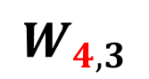
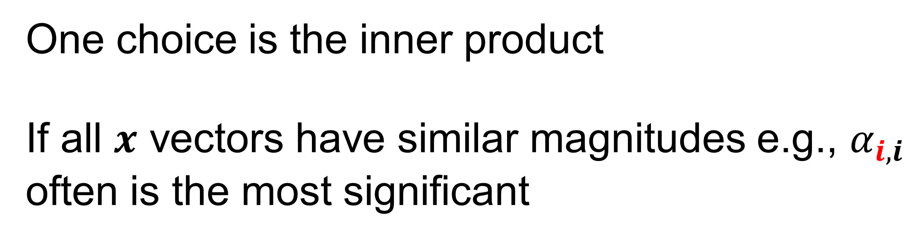

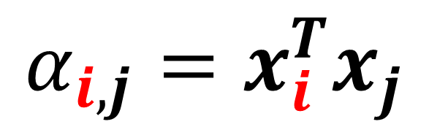
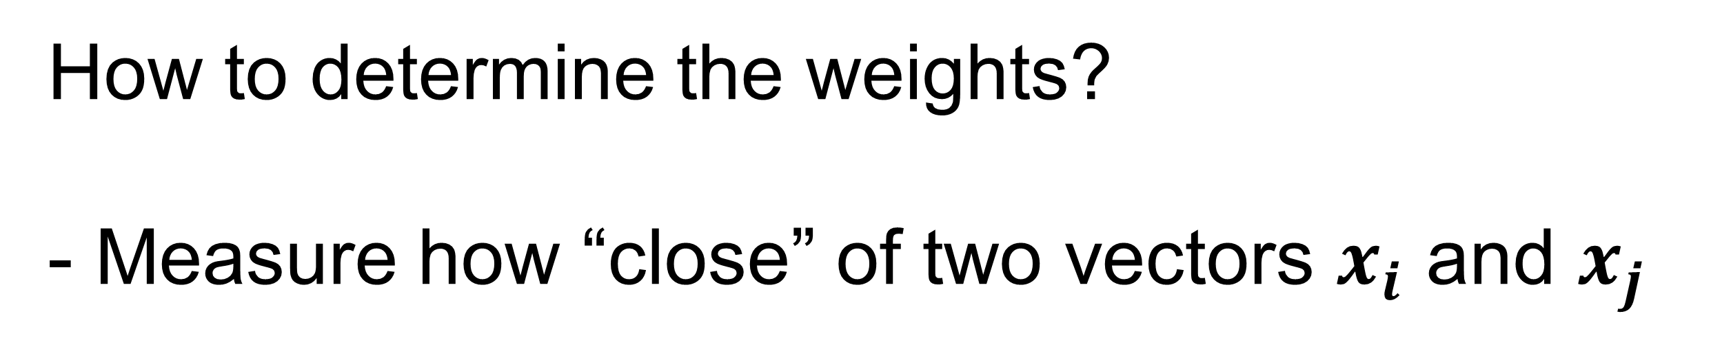
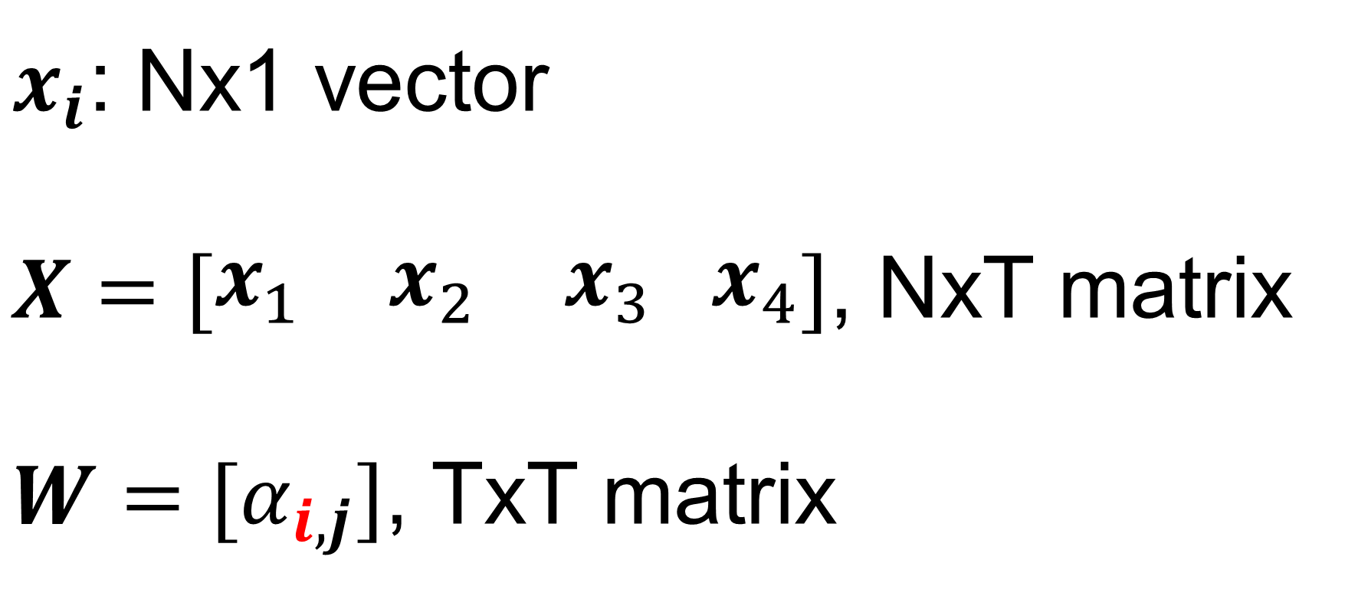
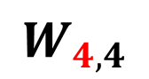
Self-attention
How to determine the weights?
- Measure how “close” of two vectors $x_{i}$ and $x_{j}$
$${\hat{y}}_{1}$$
$${\hat{y}}_{2}$$
$${\hat{y}}_{3}$$
$${\hat{y}}_{4}$$
$$α_{i,j}=x_{i}^{T}x_{j}$$
$$W_{1,4}$$
$$W_{4,1}$$
One choice is the inner product
If all $x$ vectors have similar magnitudes e.g., $α_{i,i}$ often is the most significant
$$W_{1,1}$$
$$W_{4,4}$$
$$W_{1,3}$$
$$W_{4,2}$$
$$W_{1,2}$$
$$W_{4,3}$$
$x_{i}$: Nx1 vector
$X=\left[\begin{matrix}x_{1} & x_{2} & x_{3} x_{4}\end{matrix}\right]$, NxT matrix
$W=[α_{i,j}]$, TxT matrix
$$x_{1}$$
$$x_{2}$$
$$x_{3}$$
$$x_{4}$$
T positions/locations/time steps

Slide 9
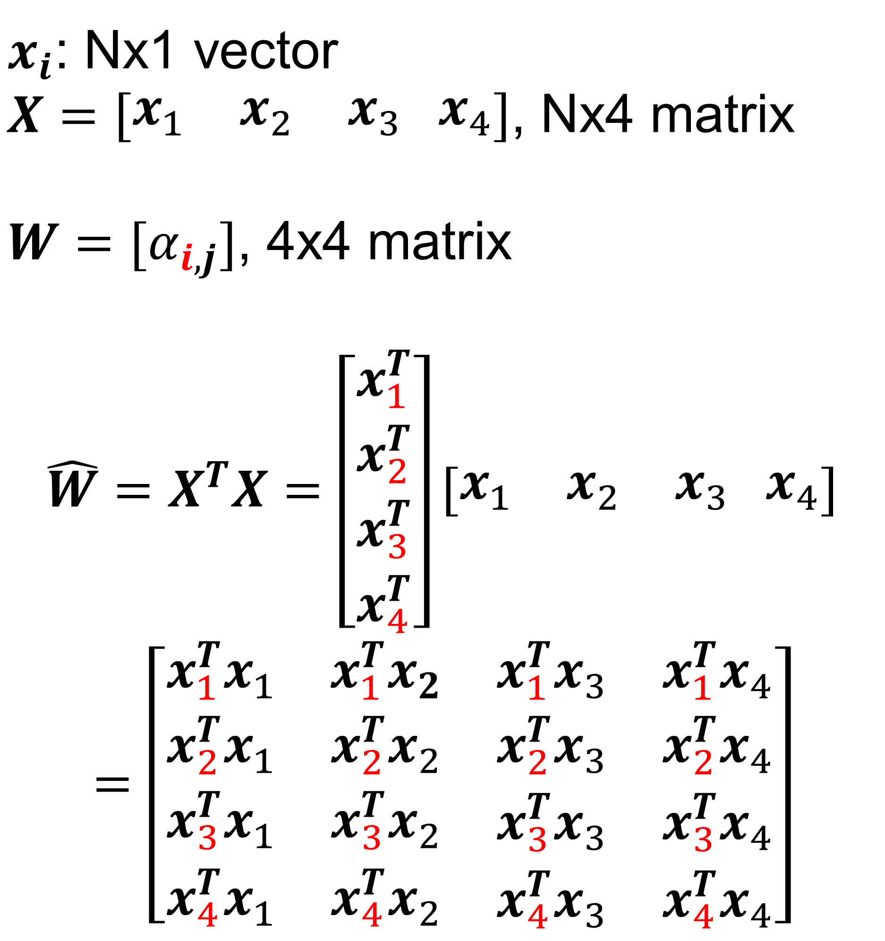
Self-attention
$x_{i}$: Nx1 vector
$X=\left[\begin{matrix}x_{1} & x_{2} & x_{3} x_{4}\end{matrix}\right]$, Nx4 matrix
$W=[α_{i,j}]$, 4x4 matrix
$$\hat{W}=X^{T}X=\left[\begin{matrix}x_{1}^{T} \\ \begin{aligned}x_{2}^{T} \\ x_{3}^{T} \\ x_{4}^{T}\end{aligned}\end{matrix}\right]\left[\begin{matrix}x_{1} & x_{2} & x_{3} x_{4}\end{matrix}\right]$$
$$=\left[\begin{matrix}\begin{aligned}x_{1}^{T}x_{1} \\ x_{2}^{T}x_{1}\end{aligned} & \begin{aligned}x_{1}^{T}x_{2} \\ x_{2}^{T}x_{2}\end{aligned} & \begin{aligned}\begin{matrix}x_{1}^{T}x_{3} & x_{1}^{T}x_{4}\end{matrix} \\ \begin{matrix}x_{2}^{T}x_{3} & x_{2}^{T}x_{4}\end{matrix}\end{aligned} \\ x_{3}^{T}x_{1} & x_{3}^{T}x_{2} & \begin{matrix}x_{3}^{T}x_{3} & x_{3}^{T}x_{4}\end{matrix} \\ x_{4}^{T}x_{1} & x_{4}^{T}x_{2} & \begin{matrix}x_{4}^{T}x_{3} & x_{4}^{T}x_{4}\end{matrix}\end{matrix}\right]$$
$${\hat{y}}_{1}$$
$${\hat{y}}_{2}$$
$${\hat{y}}_{3}$$
$${\hat{y}}_{4}$$
$$W_{1,1}$$
$$W_{1,4}$$
$$W_{4,1}$$
$$W_{4,4}$$
$$W_{1,3}$$
$$W_{4,2}$$
$$W_{1,2}$$
$$W_{4,3}$$
$$x_{1}$$
$$x_{2}$$
$$x_{3}$$
$$x_{4}$$
T=4

Slide 10
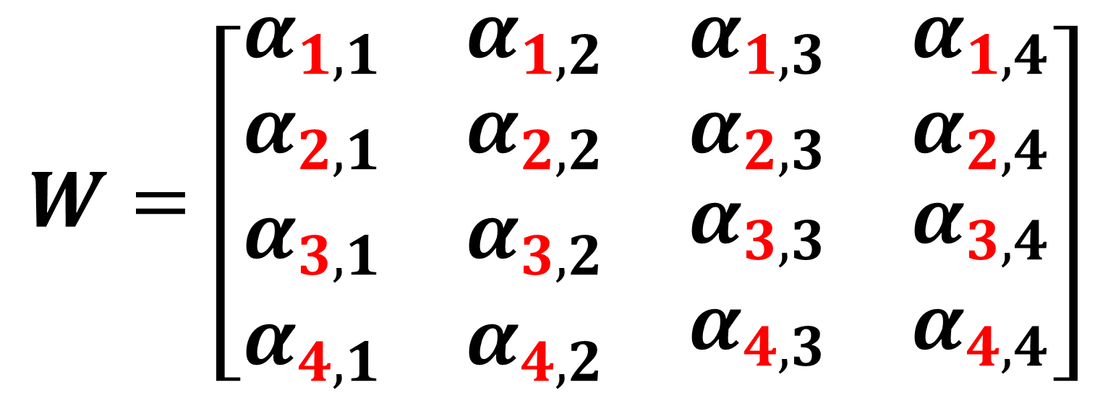
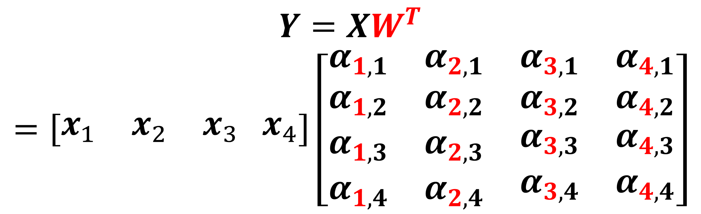
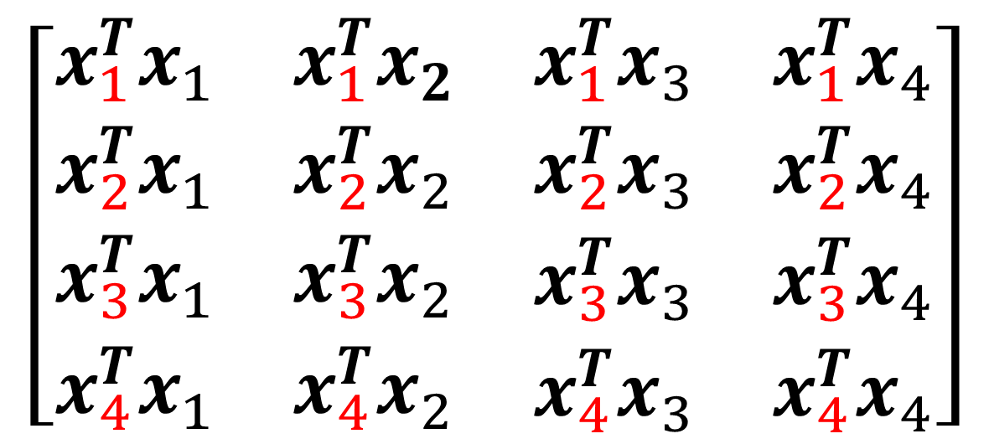
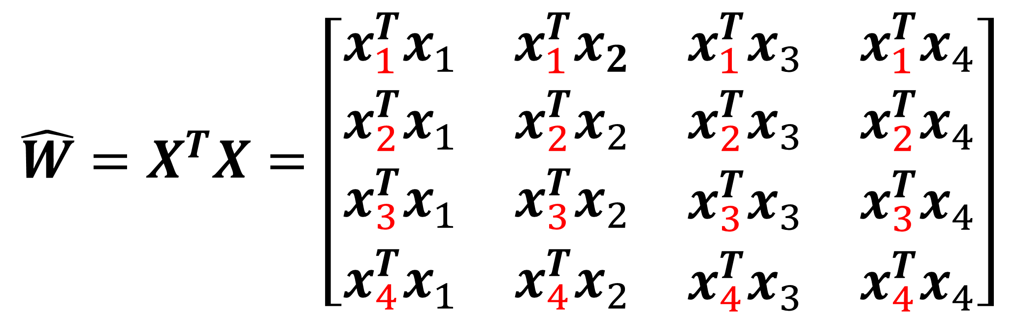
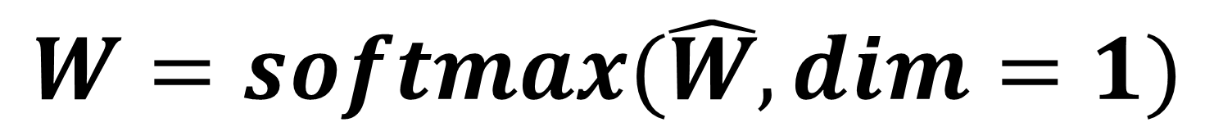
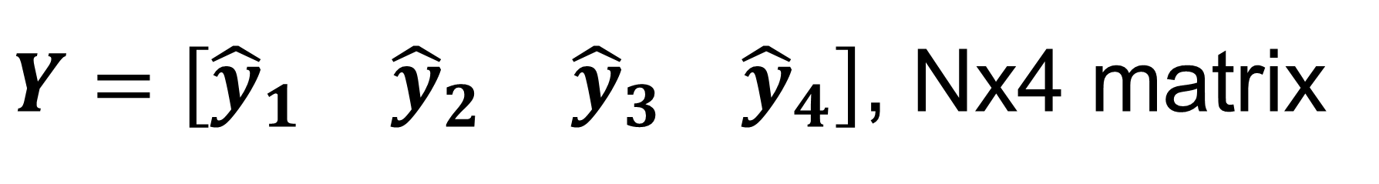
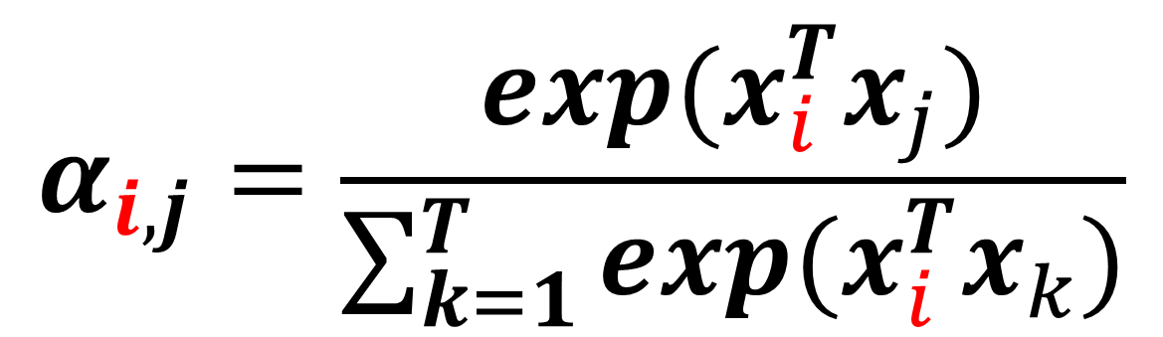
Self-attention
$$\hat{W}=X^{T}X=\left[\begin{matrix}\begin{aligned}x_{1}^{T}x_{1} \\ x_{2}^{T}x_{1}\end{aligned} & \begin{aligned}x_{1}^{T}x_{2} \\ x_{2}^{T}x_{2}\end{aligned} & \begin{aligned}\begin{matrix}x_{1}^{T}x_{3} & x_{1}^{T}x_{4}\end{matrix} \\ \begin{matrix}x_{2}^{T}x_{3} & x_{2}^{T}x_{4}\end{matrix}\end{aligned} \\ x_{3}^{T}x_{1} & x_{3}^{T}x_{2} & \begin{matrix}x_{3}^{T}x_{3} & x_{3}^{T}x_{4}\end{matrix} \\ x_{4}^{T}x_{1} & x_{4}^{T}x_{2} & \begin{matrix}x_{4}^{T}x_{3} & x_{4}^{T}x_{4}\end{matrix}\end{matrix}\right]$$
$$\left[\begin{matrix}\begin{aligned}x_{1}^{T}x_{1} \\ x_{2}^{T}x_{1}\end{aligned} & \begin{aligned}x_{1}^{T}x_{2} \\ x_{2}^{T}x_{2}\end{aligned} & \begin{aligned}\begin{matrix}x_{1}^{T}x_{3} & x_{1}^{T}x_{4}\end{matrix} \\ \begin{matrix}x_{2}^{T}x_{3} & x_{2}^{T}x_{4}\end{matrix}\end{aligned} \\ x_{3}^{T}x_{1} & x_{3}^{T}x_{2} & \begin{matrix}x_{3}^{T}x_{3} & x_{3}^{T}x_{4}\end{matrix} \\ x_{4}^{T}x_{1} & x_{4}^{T}x_{2} & \begin{matrix}x_{4}^{T}x_{3} & x_{4}^{T}x_{4}\end{matrix}\end{matrix}\right]$$
Softmax along row
$$W=softmax(\hat{W}, dim=1)$$
Attention score
$Y=\left[\begin{matrix}{\hat{y}}_{1} & {\hat{y}}_{2} & {\hat{y}}_{3} {\hat{y}}_{4}\end{matrix}\right]$, Nx4 matrix
$$W=\left[\begin{matrix}\begin{aligned}α_{1,1} \\ α_{2,1}\end{aligned} & \begin{aligned}α_{1,2} \\ α_{2,2}\end{aligned} & \begin{aligned}\begin{matrix}α_{1,3} & α_{1,4}\end{matrix} \\ \begin{matrix}α_{2,3} & α_{2,4}\end{matrix}\end{aligned} \\ α_{3,1} & α_{3,2} & \begin{matrix}α_{3,3} & α_{3,4}\end{matrix} \\ α_{4,1} & α_{4,2} & \begin{matrix}α_{4,3} & α_{4,4}\end{matrix}\end{matrix}\right]$$
$$Y=XW^{T}$$
$$=\left[\begin{matrix}x_{1} & x_{2} & x_{3} x_{4}\end{matrix}\right]\left[\begin{matrix}\begin{aligned}α_{1,1} \\ α_{1,2}\end{aligned} & \begin{aligned}α_{2,1} \\ α_{2,2}\end{aligned} & \begin{aligned}\begin{matrix}α_{3,1} & α_{4,1}\end{matrix} \\ \begin{matrix}α_{3,2} & α_{4,2}\end{matrix}\end{aligned} \\ α_{1,3} & α_{2,3} & \begin{matrix}α_{3,3} & α_{4,3}\end{matrix} \\ α_{1,4} & α_{2,4} & \begin{matrix}α_{3,4} & α_{4,4}\end{matrix}\end{matrix}\right]$$
$$α_{i,j}=\frac{exp(x_{i}^{T}x_{j})}{\sum_{k=1}^{T}{exp(x_{i}^{T}x_{k})}}$$
$${\hat{y}}_{1}=α_{1,1}x_{1}+α_{1,2}x_{2}+α_{1,3}x_{3}+α_{1,4}x_{4}$$

Slide 11
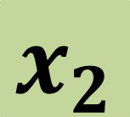

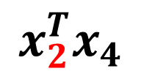

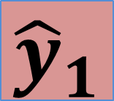




















Self-attention
$x_{i}$: Nx1 vector
$X=\left[\begin{matrix}x_{1} & x_{2} & x_{3} x_{4}\end{matrix}\right]$, NxT matrix
$\hat{W}=X^{T}X$, TxT matrix
$W=softmax\left(\hat{W}, dim=1\right)=[α_{i,j}]$, TxT matrix
$Y=\left[\begin{matrix}{\hat{y}}_{1} & {\hat{y}}_{2} & {\hat{y}}_{3} {\hat{y}}_{4}\end{matrix}\right]=XW^{T}$, NxT matrix
We want to compute output at this position
$${\hat{y}}_{1}$$
$${\hat{y}}_{2}$$
$${\hat{y}}_{3}$$
$${\hat{y}}_{4}$$
+
$$x_{2}$$
×
$$x_{2}$$
×
$$x_{2}$$
×
$$x_{2}$$
×
$$α_{2,1}$$
$$α_{2,2}$$
$$α_{2,3}$$
$$α_{2,4}$$
softmax
$${\hat{y}}_{i}=\sum_{j=1}^{T}{α_{i,j}x_{j}}$$
$$x_{2}^{T}x_{1}$$
$$x_{2}^{T}x_{2}$$
$$x_{2}^{T}x_{3}$$
$$x_{2}^{T}x_{4}$$
Output is a weighted average of inputs
Weights measure how “close” two input vectors are
Given output position $i$, a $x_{j}$ that is “closer” to input $x_{i}$ has higher weight
$$x_{1}$$
$$x_{2}$$
$$x_{3}$$
$$x_{4}$$

Slide 12




























Attention
Self-attention
√ parallel computing
√ process sequence data
Has no learnable parameters
So let’s introduce learnable parameters
We want to compute output at this position
$${\hat{y}}_{1}$$
$${\hat{y}}_{2}$$
$${\hat{y}}_{3}$$
$${\hat{y}}_{4}$$
+
$$v_{1}$$
×
$$v_{2}$$
×
$$v_{3}$$
×
$$v_{4}$$
×
$$α_{2,1}$$
$$α_{2,2}$$
$$α_{2,3}$$
$$α_{2,4}$$
softmax
$${q_{i}=W_{q}x}_{i}$$
query
Bias term can be added too
$$q_{2}^{T}k_{1}$$
$$q_{2}^{T}k_{2}$$
$$q_{2}^{T}k_{3}$$
$$q_{2}^{T}k_{4}$$
$${k_{i}=W_{k}x}_{i}$$
key
$$q_{2}$$
$$q_{2}$$
$$k_{3}$$
$$q_{2}$$
$${v_{i}=W_{v}x}_{i}$$
value
$$v_{i}$$
$$k_{1}$$
$$q_{2}$$
$$k_{2}$$
$$k_{4}$$
$W_{q}$ and $W_{k}$ : DxN matrix
$W_{v}$ : VxN matrix
Q and K : DxT matrix
V: VxT matrix
D is the working dimension of attention
$${ W}_{v}$$
$${ W}_{k}$$
$${ W}_{q}$$
$${ W}_{k}$$
$${ W}_{k}$$
$${ W}_{k}$$
$$x_{i}$$
$$x_{1}$$
$$x_{2}$$
$$x_{3}$$
$$x_{4}$$

Slide 13







Attention
$x_{i}$: Nx1 vector
$X=\left[\begin{matrix}x_{1} & x_{2} & x_{3} x_{4}\end{matrix}\right]$, NxT matrix
$W_{q}$ and $W_{k}$: DxN matrix; $W_{v}$: VxN matrix
$Q=W_{q}X$, DxT matrix
$K=W_{k}X$, DxT matrix
$V=W_{v}X$, VxT matrix
$\hat{W}=Q^{T}K$, TxT matrix
$W=softmax\left(\hat{W}, dim=1\right)=[α_{i,j}]$, TxT matrix
$Y=VW^{T}$, VxT matrix
We want to compute output at this position
$${\hat{y}}_{1}$$
$${\hat{y}}_{2}$$
$${\hat{y}}_{3}$$
$${\hat{y}}_{4}$$
+
$$v_{1}$$
×
$$v_{2}$$
×
$$v_{3}$$
×
$$v_{4}$$
×
Learnable parameters:
$W_{q}$, $W_{k}$, $W_{v}$
Do not depend on T
$$α_{2,1}$$
$$α_{2,2}$$
$$α_{2,3}$$
$$α_{2,4}$$
softmax
$$q_{2}^{T}k_{1}$$
$$q_{2}^{T}k_{2}$$
$$q_{2}^{T}k_{3}$$
$$q_{2}^{T}k_{4}$$
$$k_{1}$$
$$q_{2}$$
$$k_{2}$$
$$k_{3}$$
$$k_{4}$$
$$x_{2}$$

Slide 14




Scaled Attention
$$α_{i,j}=\frac{q_{i}^{T}k_{j}}{\sqrt{D}}$$
$$α_{i,j}=q_{i}^{T}k_{j}$$
$\hat{W}=\frac{Q^{T}K}{\sqrt{D}}$, TxT matrix
Dot product increases with higher dimension
A unit vector of dimension D has length $\sqrt{D}$

Slide 15


















Multi-head Attention
$${\hat{y}}_{1}^{1}$$
$${\hat{y}}_{2}^{1}$$
$${\hat{y}}_{3}^{1}$$
$${\hat{y}}_{4}^{1}$$
$${\hat{y}}_{1}^{2}$$
$${\hat{y}}_{2}^{2}$$
$${\hat{y}}_{3}^{2}$$
$${\hat{y}}_{4}^{2}$$
$W_{q}^{1}$,$W_{k}^{1}$,$W_{v}^{1}$
$W_{q}^{2}$,$W_{k}^{2}$,$W_{v}^{2}$
$$x_{1}$$
$$x_{2}$$
$$x_{3}$$
$$x_{4}$$
Increase representation power to capture multiple possible relevance across long time points
$$x_{1}$$
$$x_{2}$$
$$x_{3}$$
$$x_{4}$$

Slide 16


















Multi-head Attention
$${\hat{y}}_{1}^{1}$$
$${\hat{y}}_{2}^{1}$$
$${\hat{y}}_{3}^{1}$$
$${\hat{y}}_{4}^{1}$$
$${\hat{y}}_{1}^{2}$$
$${\hat{y}}_{2}^{2}$$
$${\hat{y}}_{3}^{2}$$
$${\hat{y}}_{4}^{2}$$
$W_{q}^{1}$,$W_{k}^{1}$,$W_{v}^{1}$
$W_{q}^{2}$,$W_{k}^{2}$,$W_{v}^{2}$
$$x_{1}$$
$$x_{2}$$
$$x_{3}$$
$$x_{4}$$
$${\hat{y}}_{1}=W_{o}\left[\begin{matrix}{\hat{y}}_{1}^{1} \\ {\hat{y}}_{1}^{2}\end{matrix}\right]$$
$W_{o}$: Vx2V matrix, learnable parameter
Also possible to split input vector into chunks, e.g. if H=2 for two heads,
$$x_{1}$$
$x_{1}^{1}=$ $x_{1}[0:N/2]$, $x_{1}^{2}=$ $x_{1}[N/2:N]$
Nx1

Slide 17

Attention is a set-to-set operation
$${\hat{y}}_{1}$$
$${\hat{y}}_{2}$$
$${\hat{y}}_{3}$$
$${\hat{y}}_{4}$$
Computational operations for $x_{i}$ and $x_{j}$ are 100% identical
If we switch position of $x_{i}$ and $x_{j}$, outputs stay the same, but only with switched position
if $x_{i}⟺x_{j}$, then ${\hat{y}}_{i}⟺{\hat{y}}_{j}$
$$x_{1}$$
$$x_{2}$$
$$x_{3}$$
$$x_{4}$$

Slide 18





Attention is a set-to-set operation
$${\hat{y}}_{1}$$
$${\hat{y}}_{3}$$
$${\hat{y}}_{2}$$
$${\hat{y}}_{4}$$
Computational operations for $x_{i}$ and $x_{j}$ are 100% identical
If we switch position of $x_{i}$ and $x_{j}$, outputs stay the same, but only with switched position
if $x_{i}⟺x_{j}$, then ${\hat{y}}_{i}⟺{\hat{y}}_{j}$
Attention(Permute(X))=Permute(Attention(X))
Non-causal
$$x_{1}$$
$$x_{3}$$
$$x_{2}$$
$$x_{4}$$

Slide 19








Add position information: Position encoding
Position encoding
A designed function to map position to a N dimensional vector
$$p=f(loc)$$
Add position vector to input
$${\hat{y}}_{1}$$
$${\hat{y}}_{2}$$
$${\hat{y}}_{3}$$
$${\hat{y}}_{4}$$
Handcrafted, but can work well
$p$ vector
$$x_{1}+p_{1}$$
$$x_{2}+p_{2}$$
$$x_{3}+p_{3}$$
$$x_{4}+p_{4}$$
Attention Is All You Need. https://arxiv.org/abs/1706.03762

Slide 20


Add position information: Position embedding
Position embedding
$$p=f(loc)$$
Learn the mapping function f
Add position vector to input
Limited by the sequence length, less flexible
$${\hat{y}}_{1}$$
$${\hat{y}}_{2}$$
$${\hat{y}}_{3}$$
$${\hat{y}}_{4}$$
$$x_{1}+p_{1}$$
$$x_{2}+p_{2}$$
$$x_{3}+p_{3}$$
$$x_{4}+p_{4}$$
Learning to Encode Position for Transformer with Continuous Dynamical Model. https://arxiv.org/abs/2003.09229
https://towardsdatascience.com/master-positional-encoding-part-i-63c05d90a0c3

Slide 21








Use attention layer
$${\hat{y}}_{1}$$
$${\hat{y}}_{2}$$
$${\hat{y}}_{3}$$
$${\hat{y}}_{4}$$
As flexible as RNN
Non-causal by default
Parallel computing
Replacing RNN in many sequence models
Attention+non-linearity+FC or CONV -> a transformer module
$$x_{1}$$
$$x_{2}$$
$$x_{3}$$
$$x_{4}$$

Slide 22








Use attention layer
Global pooling
$${\hat{y}}_{1}$$
$${\hat{y}}_{2}$$
$${\hat{y}}_{3}$$
$${\hat{y}}_{4}$$
Sentimental analysis
I bought this TV last week. It arrived today. This TV is broken …
Positive review or negative review?
$$This$$
$$TV$$
$$is$$
$$broken$$

Slide 23




Use attention layer
$${\hat{y}}_{2},$$
Probability of being triggered at the 2nd time interval
$${\hat{y}}_{1}$$
$${\hat{y}}_{3}$$
$${\hat{y}}_{4}$$
ECG Waveform detection
$x_{1},$ $x_{2}$, $x_{3}$, $x_{4}$, …
$x_{1},$ $x_{2}$, $x_{3}$, $x_{4}$, …

Slide 24

Use attention layer
$${\hat{y}}_{i}=play,$$
Probability of “play” from vocabulary
Predict masked words
Only compute loss on the masked words
Parallel computing speeds up the training
……
……
……
Tom went out to [play] the tennis
Tom went out to <MSK> the tennis

Slide 25
Use attention layer: Masked attention
Masked attention
Default attention is non-causal
Masked out the attention score matrix to make it causal
went out to play
$$Y=XW^{T}$$
$${\hat{y}}_{1}=α_{1,1}x_{1}+α_{1,2}x_{2}+α_{1,3}x_{3}+α_{1,4}x_{4}$$
$${\hat{y}}_{2}=α_{2,1}x_{1}+α_{2,2}x_{2}+α_{2,3}x_{3}+α_{2,4}x_{4}$$
$${\hat{y}}_{3}=α_{2,1}x_{1}+α_{2,2}x_{2}+α_{2,3}x_{3}+α_{2,4}x_{4}$$
$${\hat{y}}_{4}=α_{2,1}x_{1}+α_{2,2}x_{2}+α_{2,3}x_{3}+α_{2,4}x_{4}$$
Tom went out to

Slide 26


Use attention layer: Masked attention
Masked attention
Masked out the upper triangle of W matrix
Causal attention
went out to play
$$W=\left[\begin{matrix}\begin{aligned}α_{1,1} \\ α_{2,1}\end{aligned} & \begin{aligned}α_{1,2} \\ α_{2,2}\end{aligned} & \begin{aligned}\begin{matrix}α_{1,3} & α_{1,4}\end{matrix} \\ \begin{matrix}α_{2,3} & α_{2,4}\end{matrix}\end{aligned} \\ α_{3,1} & α_{3,2} & \begin{matrix}α_{3,3} & α_{3,4}\end{matrix} \\ α_{4,1} & α_{4,2} & \begin{matrix}α_{4,3} & α_{4,4}\end{matrix}\end{matrix}\right]$$
$$W_{masked}=\left[\begin{matrix}\begin{aligned}α_{1,1} \\ α_{2,1}\end{aligned} & \begin{aligned}0 \\ α_{2,2}\end{aligned} & \begin{aligned}\begin{matrix} 0 & 0\end{matrix} \\ \begin{matrix} 0 & 0\end{matrix}\end{aligned} \\ α_{3,1} & α_{3,2} & \begin{matrix}{ α}_{3,3} & 0\end{matrix} \\ α_{4,1} & α_{4,2} & \begin{matrix}{ α}_{4,3} & 0\end{matrix}\end{matrix}\right]$$
Tom went out to

Slide 27

Transformer: A Seq2Seq model
深度学习速成课
Sole relying on the attention mechanism to model long-term dependency in a sequence
Propose the “transformer” module
Scaled attention, masked attention, multi-head attention, position encoding …
Encoder
Decoder
Cross attention
deep learning crash course
Encoder
Decoder
Input and output are sequences, with variable length
Examples: machine translation, speech recognition, image captioning …
Three components: encoder, decoder, their cross-talk
Attention Is All You Need. https://arxiv.org/abs/1706.03762

Slide 28








Transformer: Encoder
$y_{1}$, Nx1
$Y$, NxT matrix
Layer
normalization
Layer normalization
$$μ_{1}=\frac{1}{N}\sum_{k=1}^{N}{b_{1}(k)}$$
$$σ_{1}=\frac{1}{N}\sum_{k=1}^{N}{{[b_{1}\left(k\right)−μ_{1}]}^{2}}$$
$${\tilde{c}}_{1}=\frac{b_{1}−μ_{1}}{\sqrt{σ_{1}}+ε}$$
$${c_{1}=γ_{1}\tilde{c}}_{1}+β_{1}$$
FC+ReLU
$$c_{1}$$
Layer normalization along N
Attention layer is the only place to model dependency across sequence
LayerNorm and FC are applied for each vector independently
Layer
normalization
$X$ , NxT matrix
$$b_{1}$$
N is the dimensional of input sequence data
(output of word embedding layer)
T is the length of sequence
Skip connection
$a_{1}$, Nx1
Multi-head attention
Attention Is All You Need. https://arxiv.org/abs/1706.03762
$x_{1}$, Nx1,
one vector in the sequence

Slide 29

Transformer: Encoder
Recent implementation often used option (b)
Shown to improve training stability and speed
Intuitively, all inputs into attention layers have been normalized
On Layer Normalization in the Transformer Architecture. https://arxiv.org/abs/2002.04745

Slide 30
Transformer: Decoder
Same as the encoder
Same as the encoder, except using the masked attention layer
Attention Is All You Need. https://arxiv.org/abs/1706.03762

Slide 31
Transformer: Cross attention
Key and value is from encoder
Query is from decoder
Auto-regressive training
deep learning crash course
深度学习速成课
深
度
学
习
速
成
课
<end>
K
Q
V
Vocabulary size vector
Encoder
Decoder
<start>
深
度
学
习
速
成
课
deep learning crash course
Process in parallel
Teacher forcing
Attention Is All You Need. https://arxiv.org/abs/1706.03762

Slide 32





















Transformer: Cross attention
深
… …
Use encoder as the “dictionary” to store the information about input sequence
Decoder wants to know what is in the input sequence. So, do query on the “dictionary"
+
×
$$α_{1,1}$$
×
$$α_{1,2}$$
×
$$α_{1,3}$$
×
$$α_{1,4}$$
$${ W}_{v}$$
$${ W}_{k}$$
$${ W}_{q}$$
$$q_{1}$$
K
V
Q
$${ W}_{v}$$
$${ W}_{k}$$
$${ W}_{v}$$
$${ W}_{k}$$
$${ W}_{v}$$
$${ W}_{k}$$
$${ W}_{v}$$
$${ W}_{k}$$
$$y_{1}$$
$$y_{2}$$
$$y_{3}$$
$$y_{4}$$
$${ W}_{q}$$
Encoder
Masked attention, Layer Norm, Add
deep learning crash course
<start>
Attention Is All You Need. https://arxiv.org/abs/1706.03762

Slide 33






Transformer: Cross attention
度
… …
Until we get <end>
+
×
$$α_{2,1}$$
×
$$α_{2,2}$$
×
$$α_{2,3}$$
×
$$α_{2,4}$$
$${ W}_{v}$$
$${ W}_{k}$$
$${ W}_{q}$$
$$q_{2}$$
K
V
Q
$${ W}_{v}$$
$${ W}_{k}$$
$${ W}_{v}$$
$${ W}_{k}$$
$${ W}_{v}$$
$${ W}_{k}$$
$${ W}_{v}$$
$${ W}_{k}$$
$${ W}_{q}$$
$$y_{1}$$
$$y_{2}$$
$$y_{3}$$
$$y_{4}$$
Encoder
Masked attention, Layer Norm, Add
deep learning crash course
<start>
深
Attention Is All You Need. https://arxiv.org/abs/1706.03762

Slide 34
Transformer: Multiple transformer layers
Encoder
深
度
学
习
速
成
课
<end>
Take the output of encoder and feed it to all decoders to compute key and value
Encoder
Decoder
Encoder
Decoder
Encoder
Decoder
deep learning crash course
<start>
深
度
学
习
速
成
课
Attention Is All You Need. https://arxiv.org/abs/1706.03762

Slide 35

Transformer: different cross attention is possible
Layer-Wise Multi-View Decoding for Natural Language Generation. https://arxiv.org/abs/2005.08081

Slide 36


NLP models based on transformer
WuDao 2.0
June 2021
1.75 Trillion
1.6 Trillion
Pre-train the transformer backbone on large corpse of texts
Use self-supervised learning
Fine-tuning for new tasks
https://github.com/huggingface/transformers

Slide 37
Elmo:

Slide 38



Positional encoding

Slide 39



Self-attention for images
For CMR applications

Slide 40


Self-attention for images
For CMR applications

Slide 41
Elmo: Embeddings from Language Models

Slide 42


Transformer models: #para
General Language Understanding Evaluation (GLUE)

Slide 43

Transformer models: #para
https://twitter.com/i/status/1283322990625607681
哈工大讯飞联合实验室
https://gluebenchmark.com/leaderboard

Slide 44


Transformer models: #para

Slide 45
Transformer models: #para
https://github.com/sebastianruder/NLP-progress

Slide 46


Seq2seq for Object Detection
https://arxiv.org/abs/2005.12872

